Slide 1
Digital Marketing Internship
Name: Suchana Subedi
Roll No.: 12281/20
Tu Regd. No. 7-2-781-284-2020
Internship Organization: XDezo Technologies Pvt. Ltd., Pokhara
Duration: Dec 2024 – March 2025 (3 Months)
Supervisor: Mr. Dinesh Thapa (CEO) & Mr. Prabesh Ghimire (Mentor)

Slide 2
Introduction: Why Digital Marketing?
The digital economy is growing rapidly—businesses need online visibility.
Shift from traditional to digital: SEO, Social Media, Content Marketing.
My internship at XDezo Technologies helped me apply classroom knowledge to real-world campaigns.

Slide 3
Background
XDezo Technologies Pvt. Ltd. is a fast-growing IT company based in Ratnachowk, Pokhara, Nepal. Founded in 2020, XDezo specializes in digital marketing, software development, and IT consulting. Their goal is to help businesses grow online using smart, creative, and data-driven solutions.
They offer services like Digital Marketing (SEO, social media marketing, PPC ads, content management, email marketing), web and mobile app development, desktop software, and e-commerce systems. Led by CEO Dinesh Thapa, XDezo is known for delivering reliable and innovative digital solutions.
Objectives of the Internship
1. To enhance career development opportunities by applying practical skills.
2. To study user behavior patterns.
3. To study device-wise click distribution.
4. To expand professional networks and relationships within the industry.

Slide 4
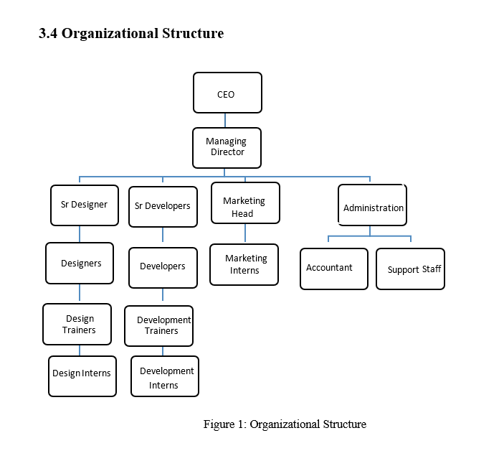
Organization Structure
Figure: Organization Structure

Slide 5
Roles and responsibilities
During my internship, I had a diverset of responsibilities, which included managing different tasks and working on various projects.
Search Engine Optimization( SEO): Analyze and optimize SEO with on-page optimization, meta tags, heading, backlinks and other SEO activities to improve views visibility and search engine ranking.
Collaborated on content marketing (blogs, infographics).
Tracked and reported performance using(Google analytics and search engine console).
Assisting with social media management: I was responsible for creating and scheduling social media posts, engaging with followers of the company.
Collaborating with team members: I was also collaborating with other team members, such as designers, developers.

Slide 6
Tools & Technologies Used
WordPress – Content Management
Canva – Graphic Design
Google Analytics & Search Console – Performance Tracking
Google My Business
Meta Business Suite

Slide 7
Key Activities Performed
SEO Optimization ( Backlinking, Meta Tags)
Content Creation (Blogs, Canva Designs, WordPress)
Social Media Management (Scheduling)
Google Tools (Analytics, Search Console, GMB)
Performance Tracking

Slide 8
Activities Performed
Executed and optimized SEO.
Created SEO-friendly blogs with proper meta tags, headers, and internal links.
Used Google Analytics & Search Console to track user behavior and content performance.
Updated Google My Business (GMB) profiles with accurate business info and images
Optimized images (alt text, filenames) for better SEO.
Built backlinks to improve website rankings.
Refreshed outdated content with new keywords, data, and links.
Improved content readability using short paragraphs and subheadings.
Designed banners, social media posts, and featured images using Canva.
Used Meta Business Suite for tracking leads and engagement.

Slide 9
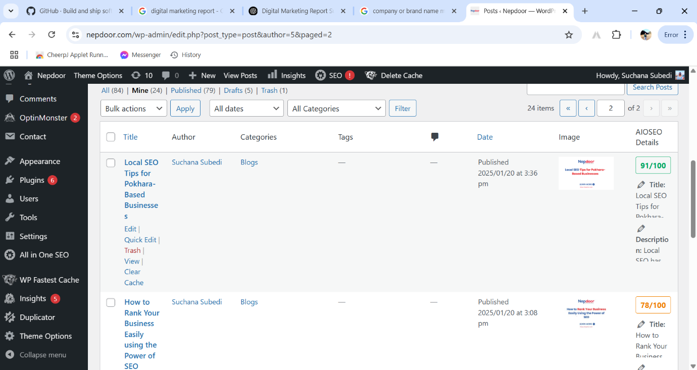
Fig: WordPress

Slide 10
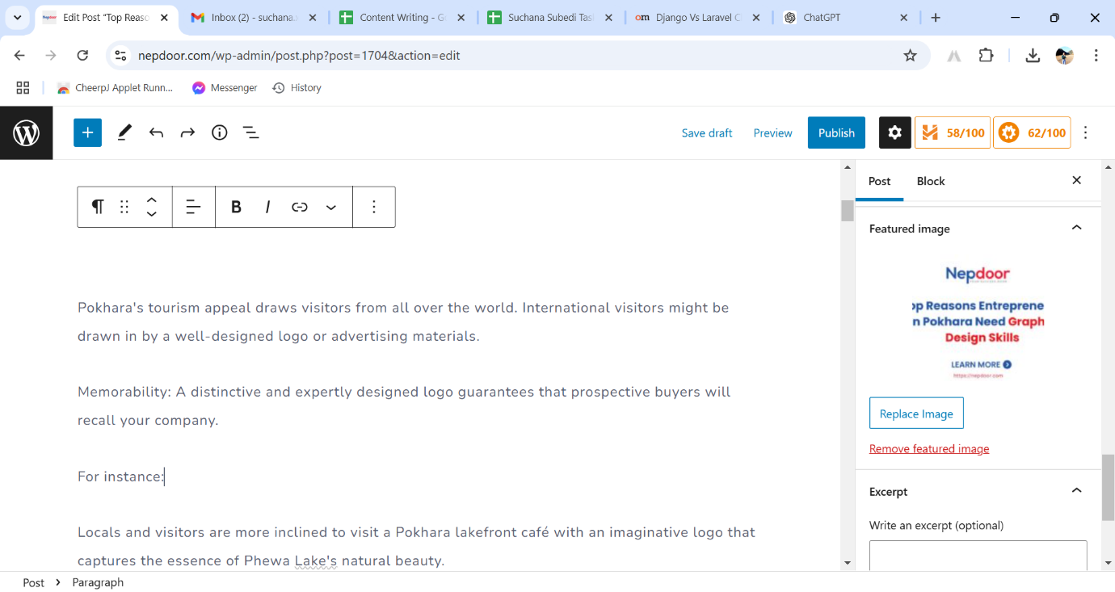
Fig: Writing Content

Slide 11
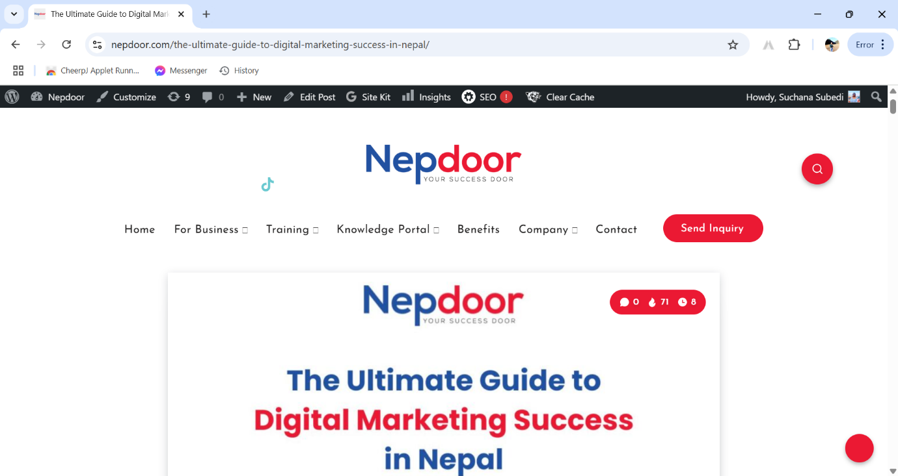
Fig : Publishing blogs

Slide 12
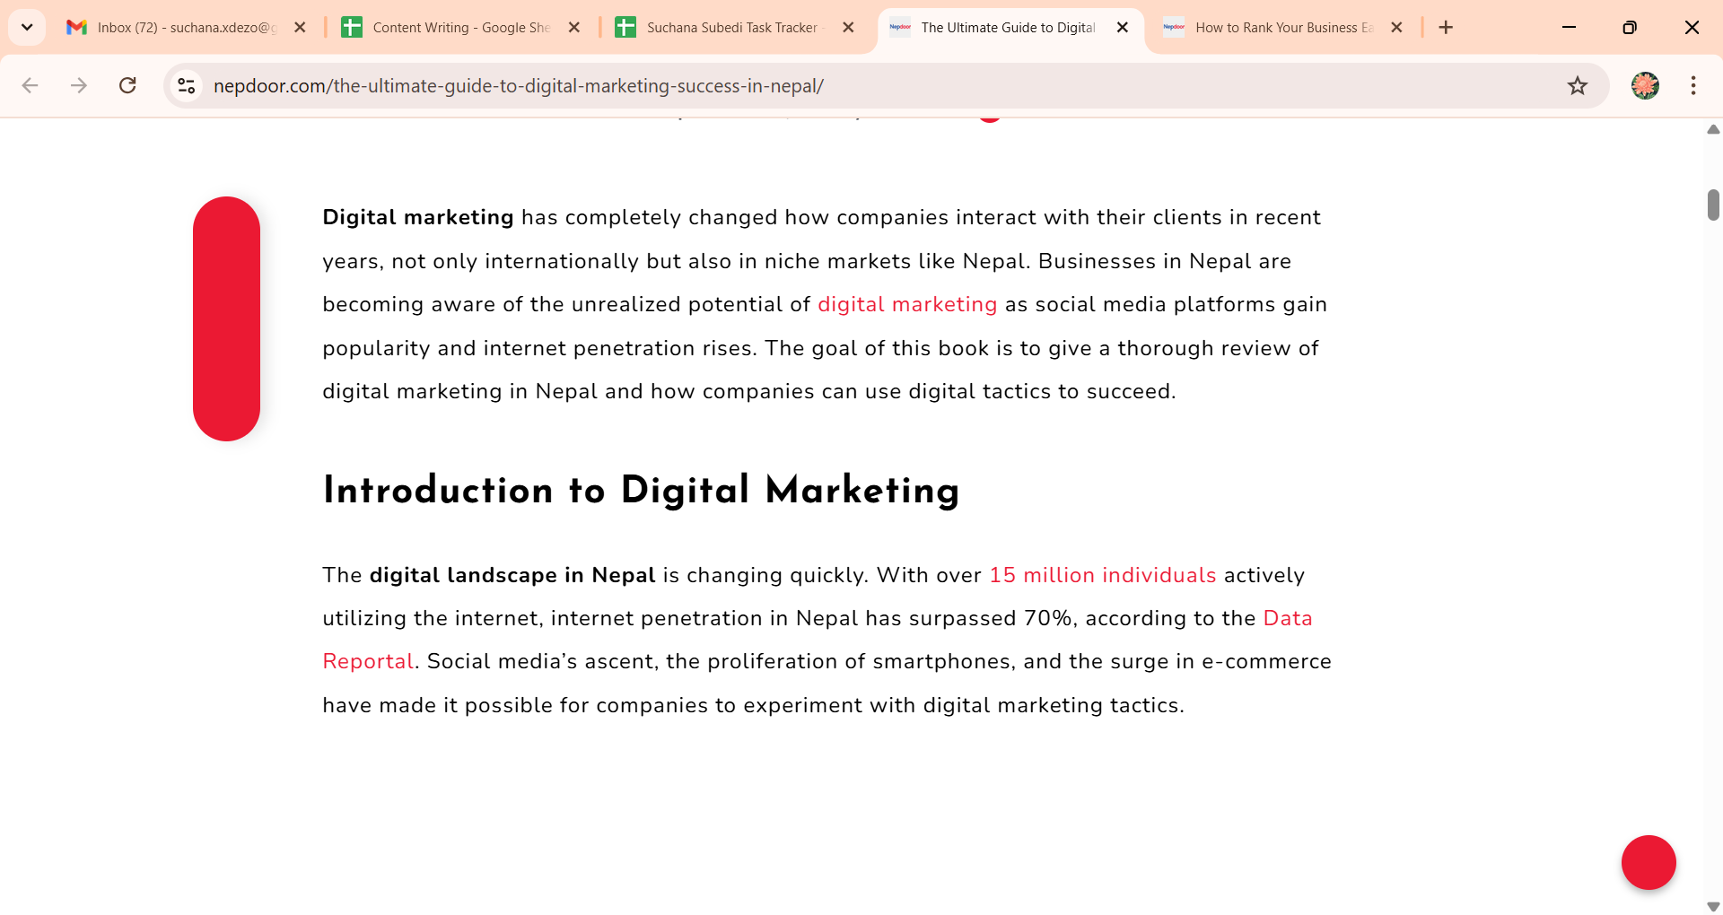

Slide 13
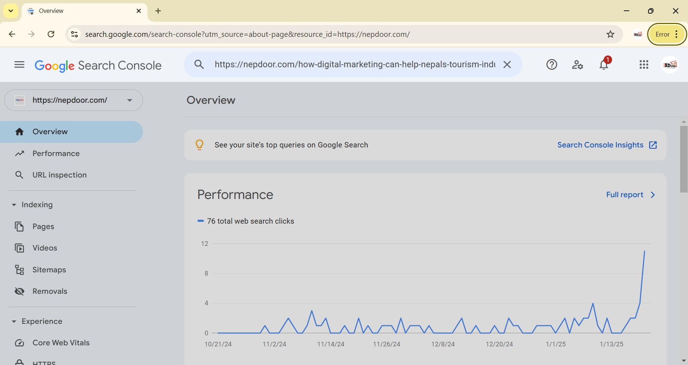
Fig : Before joining internship

Slide 14
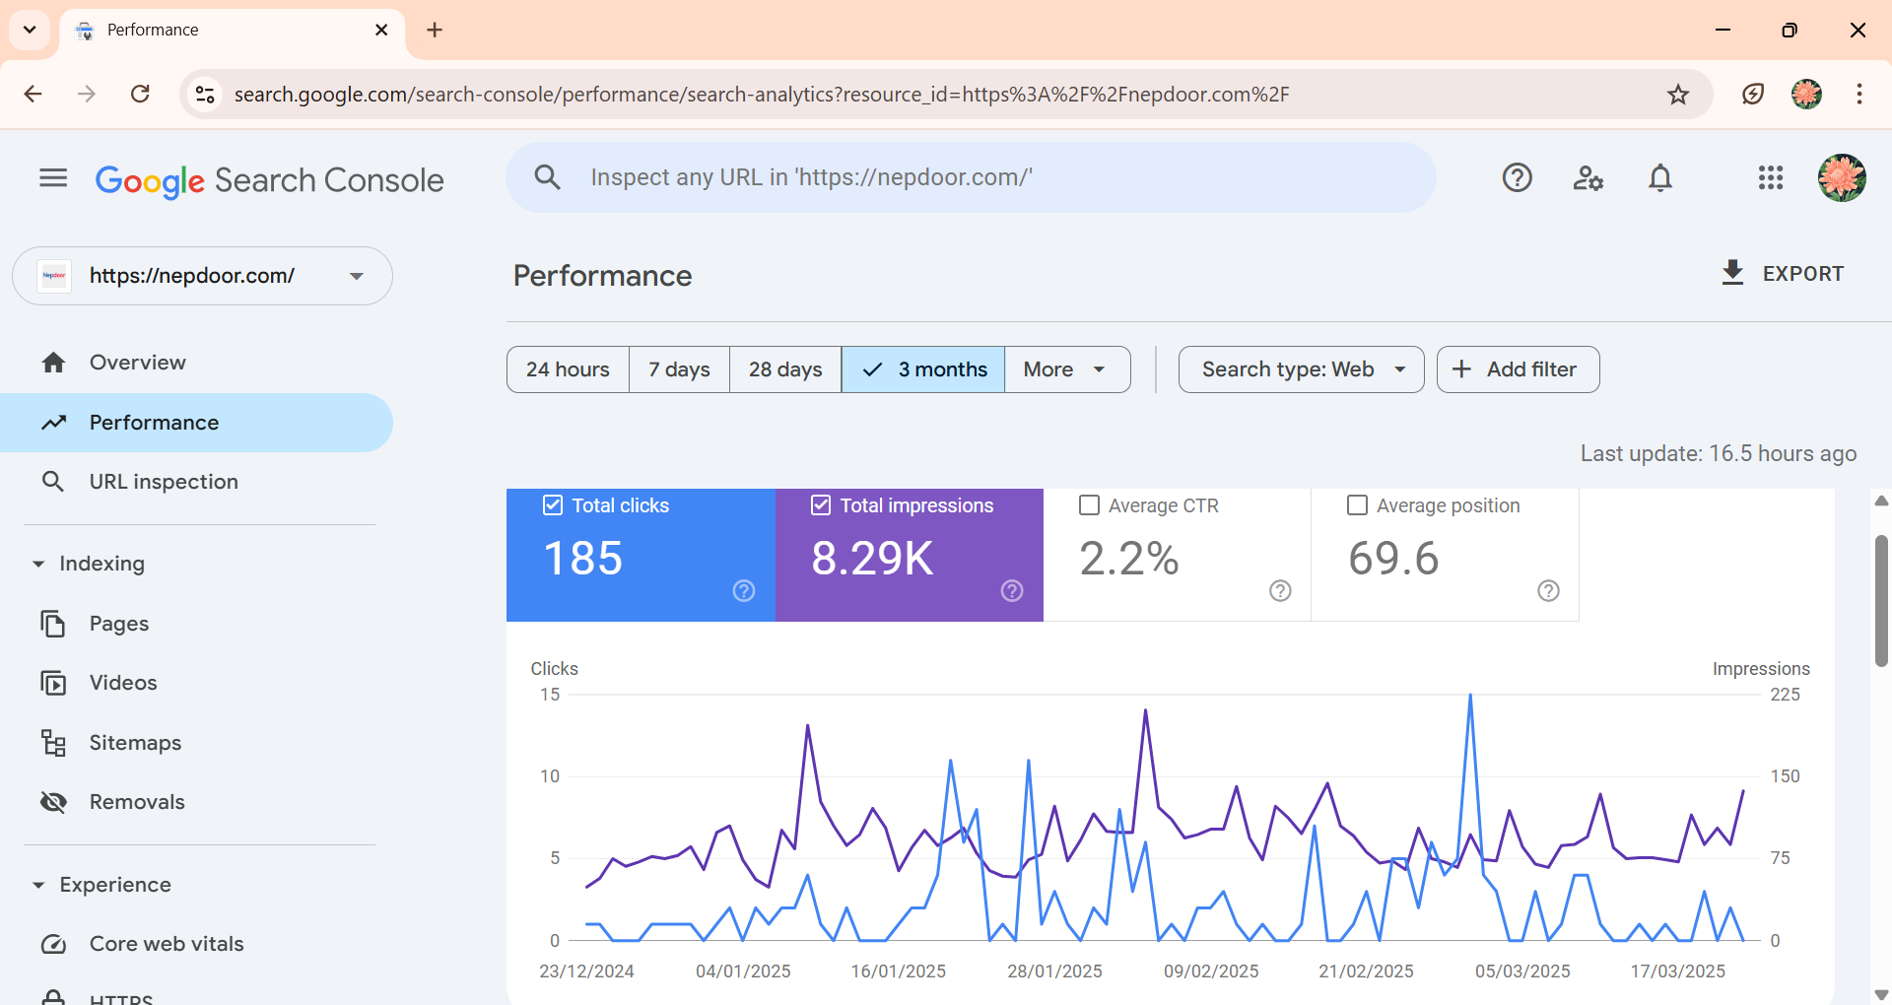
Fig : After joining internship

Slide 15
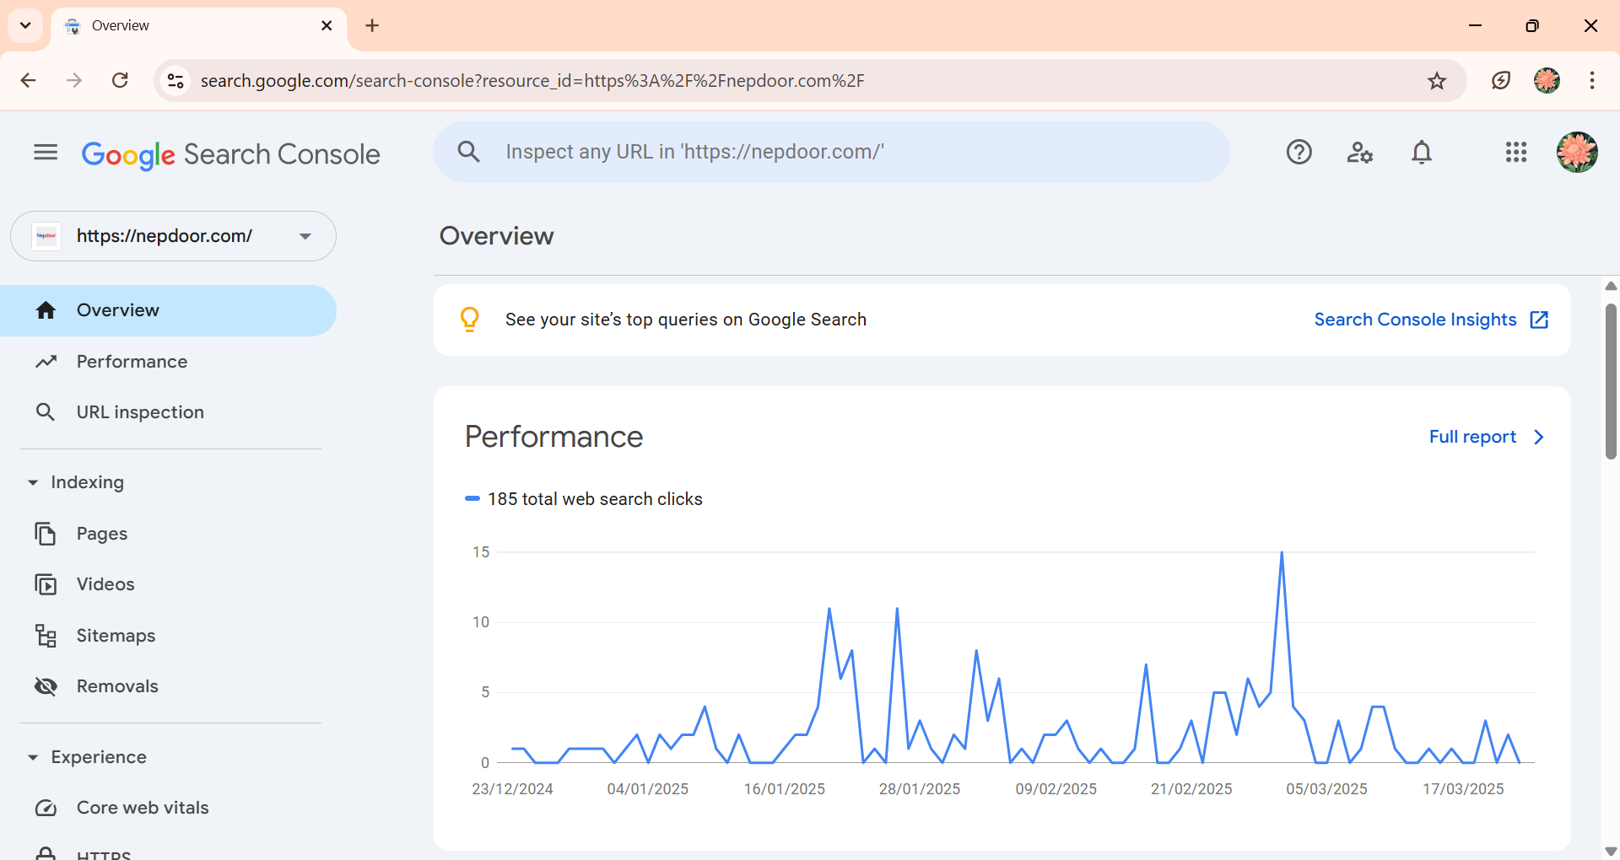

Slide 16
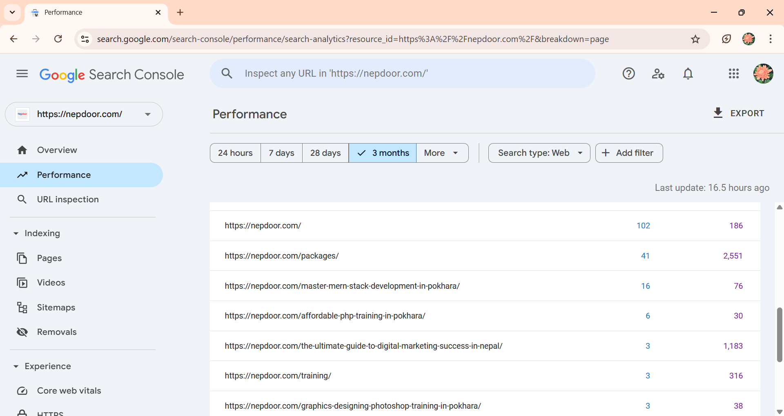

Slide 17
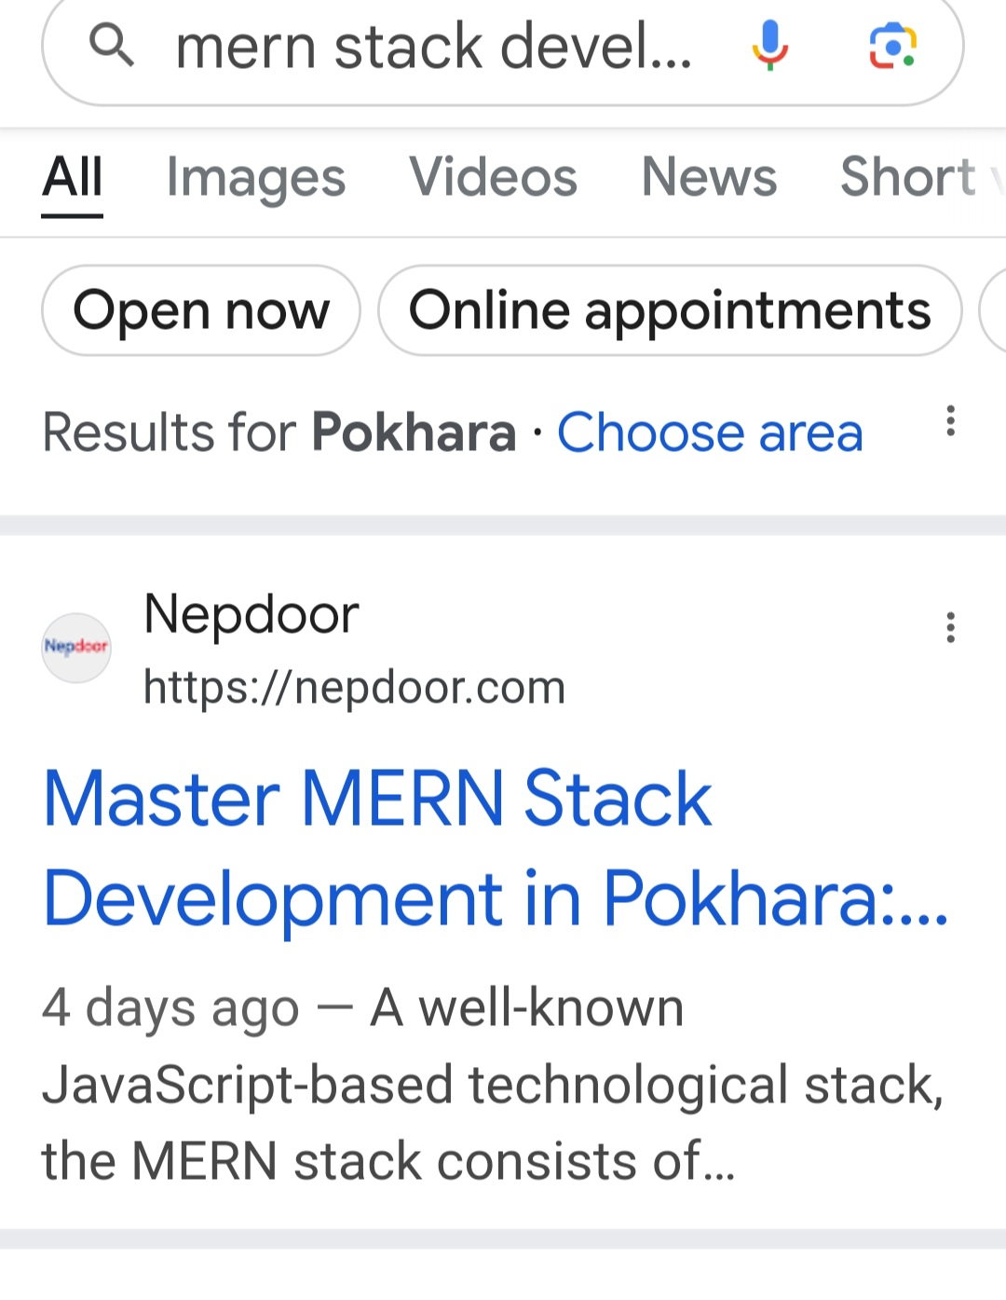

Slide 18
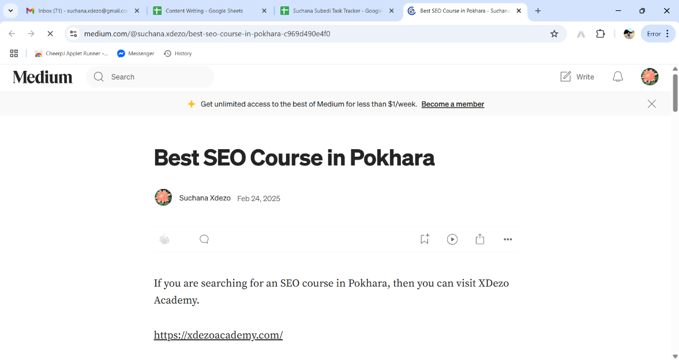

Slide 19
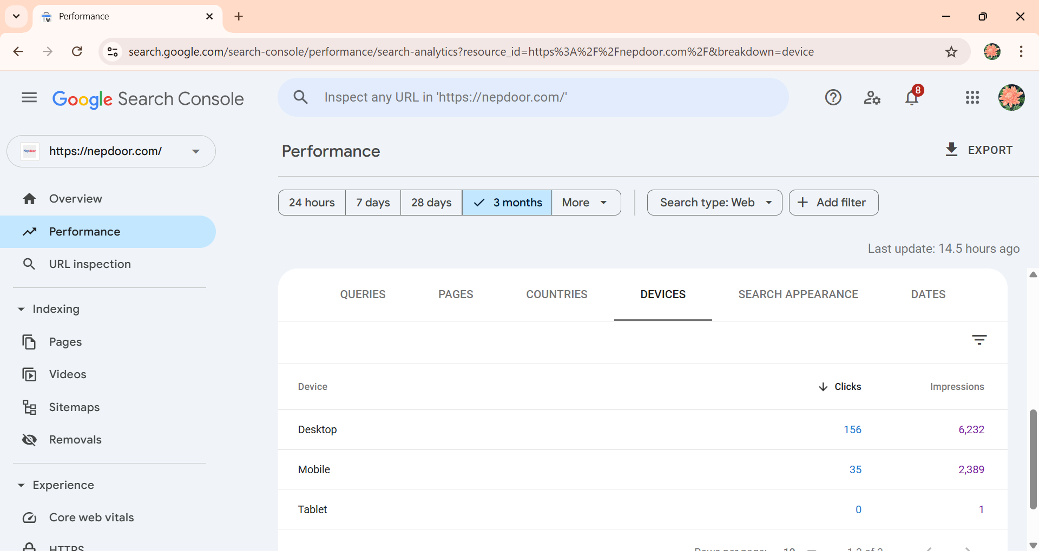
Fig: Clicking from different device

Slide 20
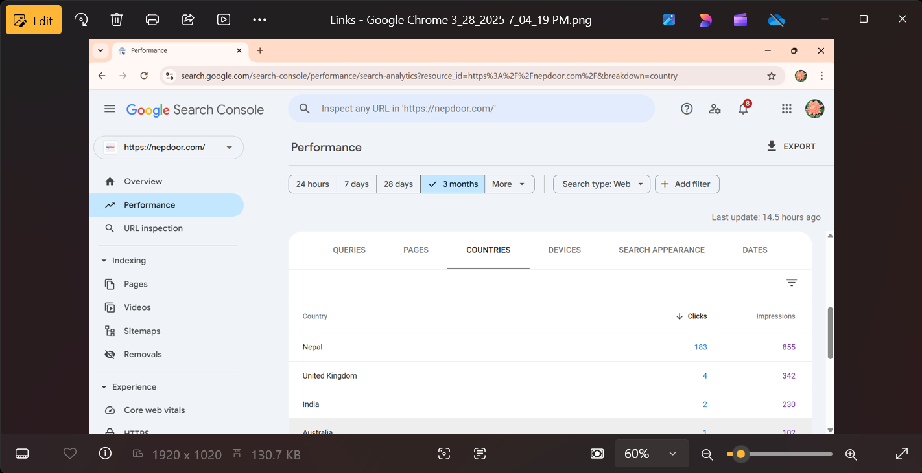
Fig :Clicking from different country

Slide 21
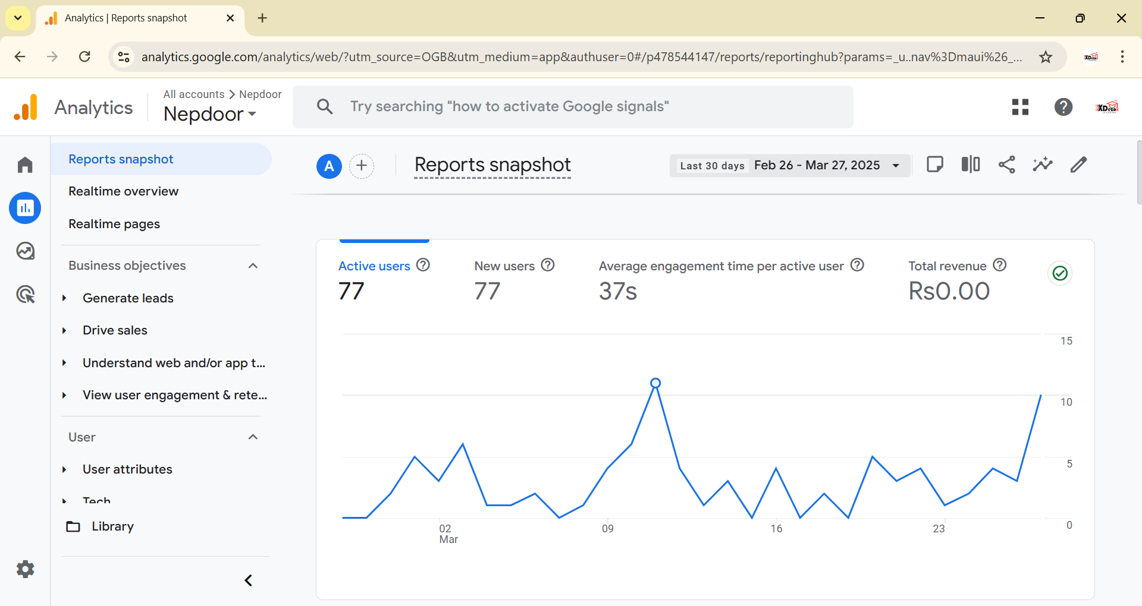
Fig: Analytics

Slide 22
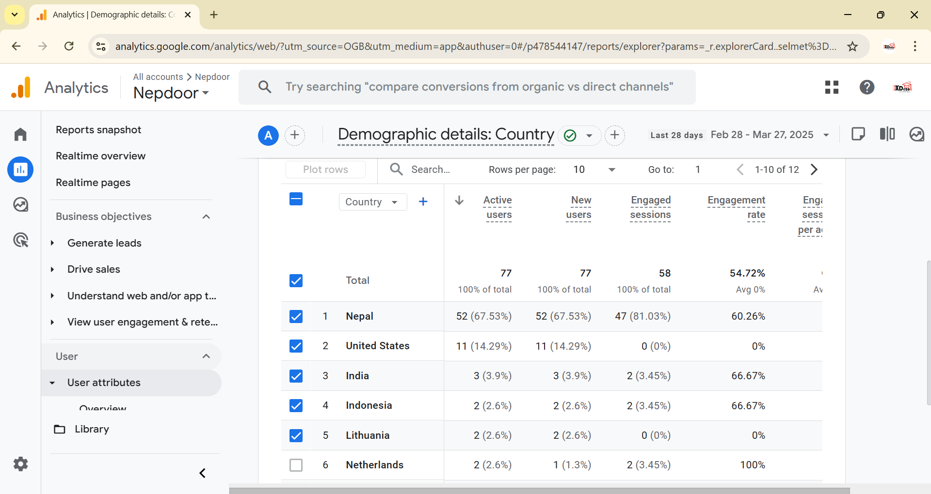

Slide 23
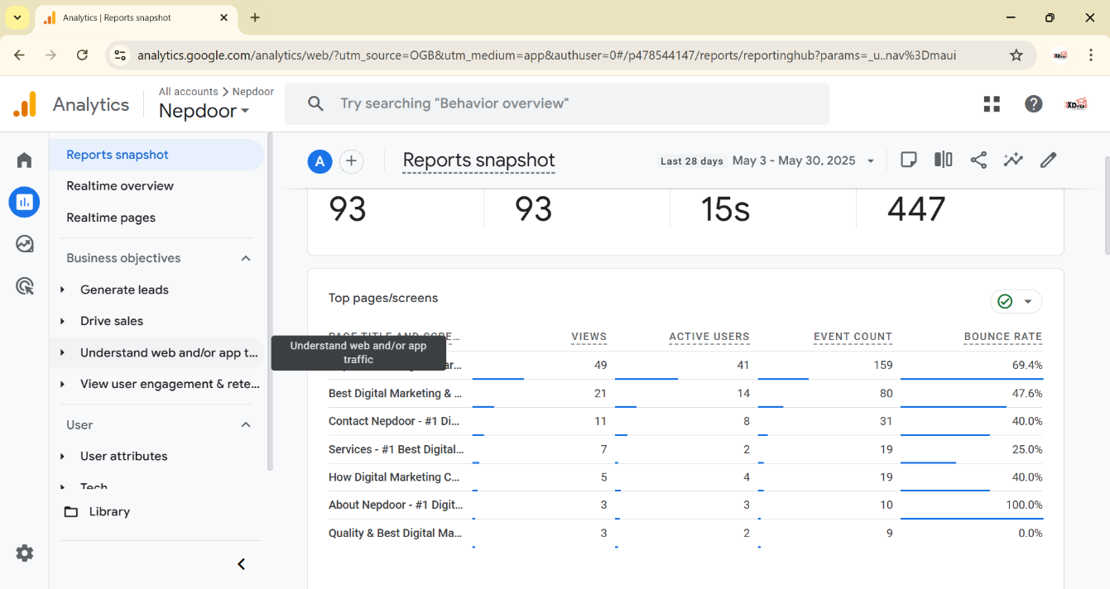

Slide 24
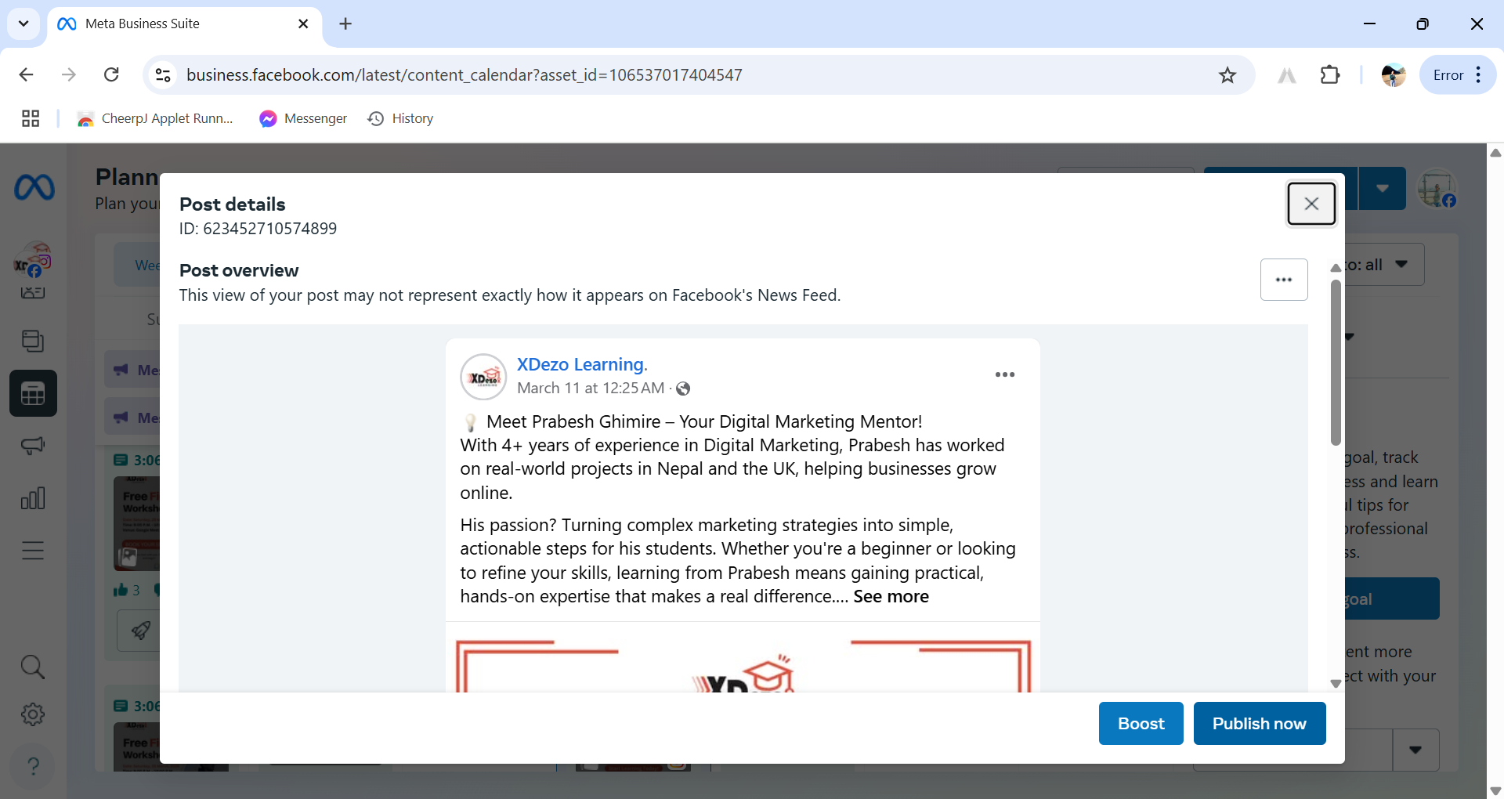
Fig: Publishing Post

Slide 25
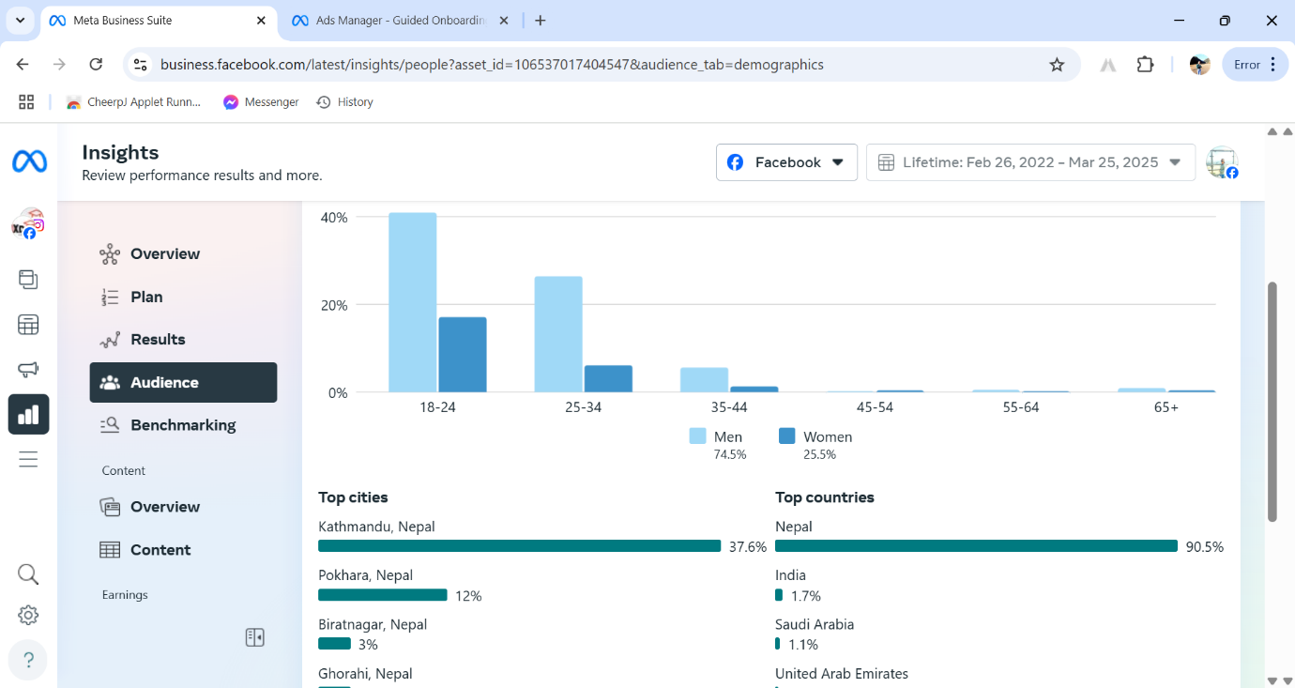
Fig : Social media Audience

Slide 26
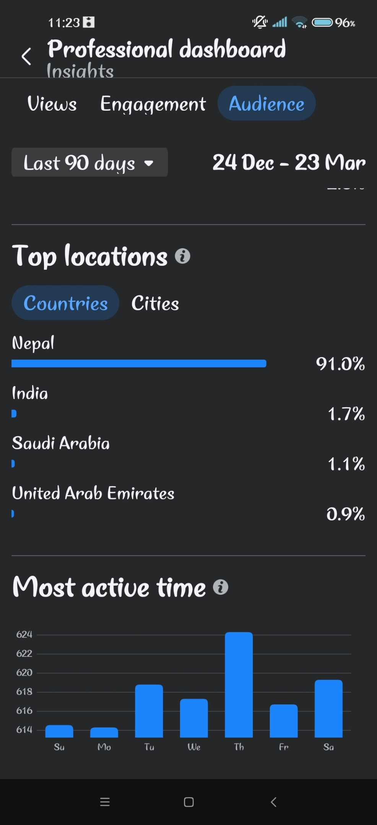

Slide 27
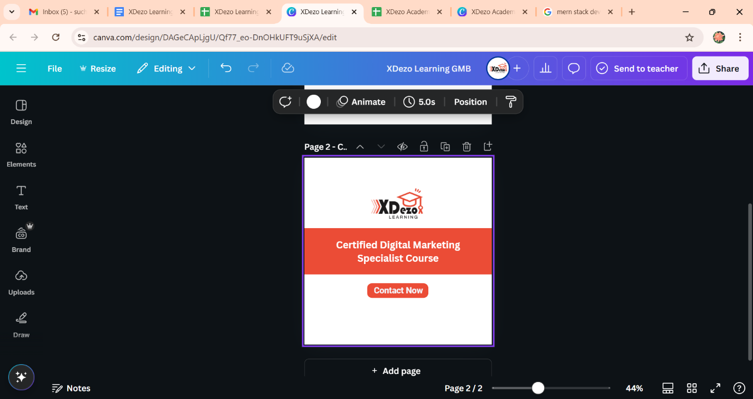
Fig : Making featured Image using Canva

Slide 28
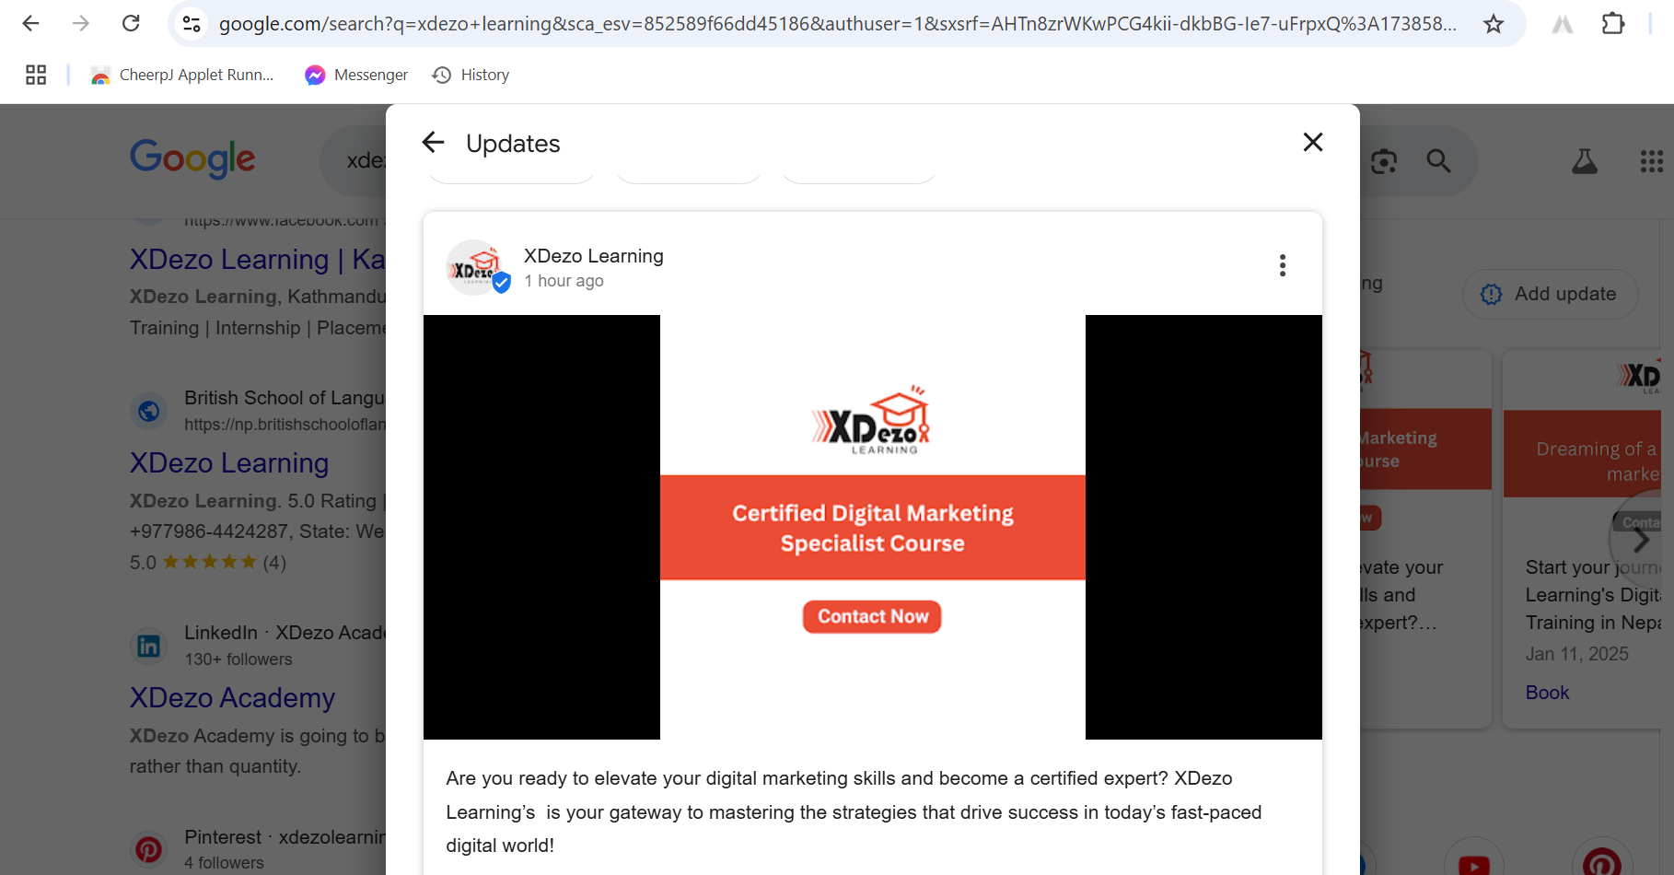
Fig : Publishing post on GMB

Slide 29
Achievements & Impact
Increased Website Traffic through SEO-optimized blogs.
Built High-Quality Backlinks for better domain authority.
Improved Social Media Engagement.
Reduced Bounce Rate by optimizing page speed and content.

Slide 30
Conclusion
Real-World Skills: This internship helped me apply classroom knowledge to actual digital marketing campaigns.
Confidence Boost: I now understand SEO, social media, and analytics much better.
I'm excited to apply these lessons as I progress in my career and continue growing as a digital marketing professional. The knowledge gained and connections made during this internship will undoubtedly influence my career. I'm grateful for the opportunity to learn from experienced professionals.

Slide 31
“Thank you!”

